Slide 1
THE COVID -19 ANALYSIS REPORT

Slide 2

THE PROBLEM
COVID-19, caused by the SARS-CoV-2 virus, is a global pandemic that has disrupted lives, economies, and healthcare systems since its emergence in late 2019. The disease spreads rapidly, resulting in varying rates of infection, recovery, and fatalities across continents and regions.
This project leverages a Kaggle COVID-19 dataset to analyze key metrics, including total cases, total deaths, active cases, total recoveries, population distribution, and mortality rates. The analysis is segmented by continent, country, and WHO-designated regions

Slide 3
Odeh glory
Data analyst
OG
Awoyemi omolabake
Data analyst
AO
The Pandemic insight team
Aibangbee Osayande
Data analyst
AO
OI
Olabimpe igbokoyi
Data Analyst
Oluwadamilola Ajibuwa
Data Analyst
OA

Slide 4
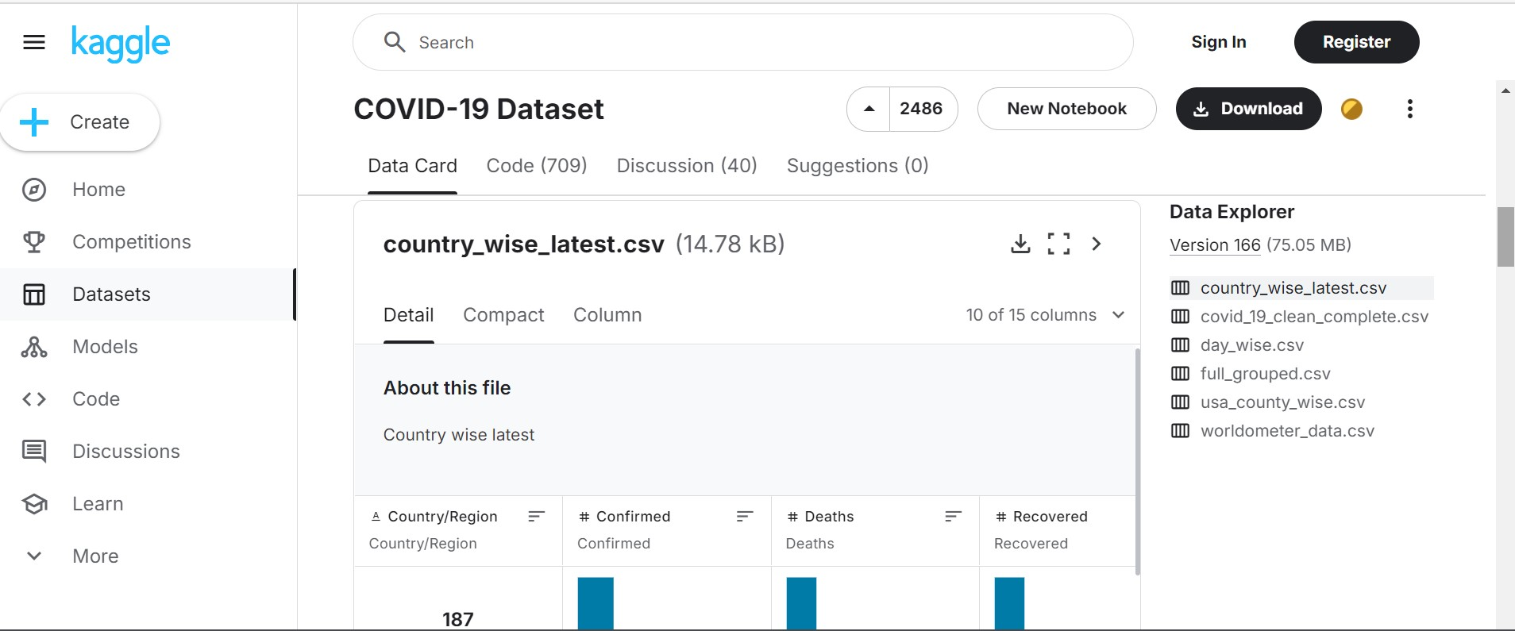
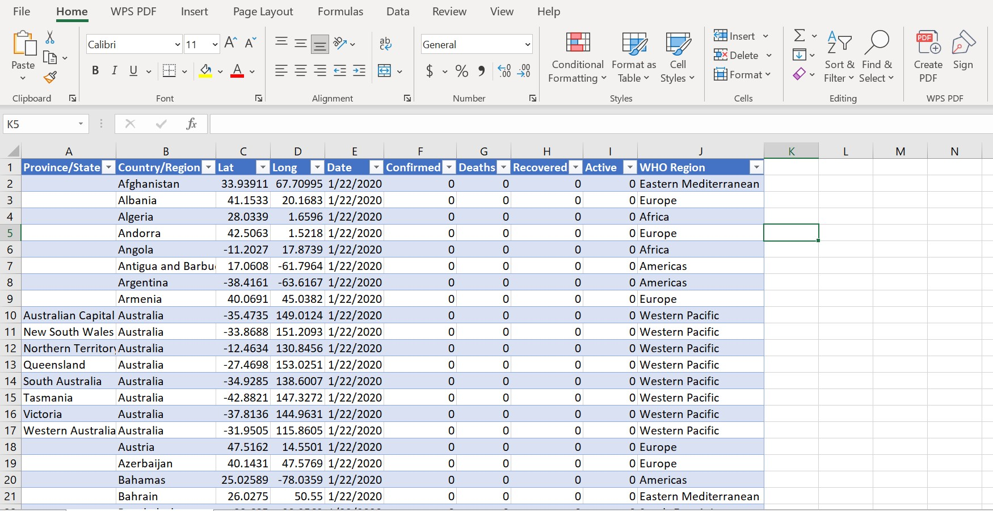
DATA PROCESS
DATA SOURCE
KAGGLE : COVID-19 DATASET
DATA CLEANING
EXCEL AND SQL
DATA TRANSFORMATION AND VISUALIZATION
POWERBI

Slide 5
Highlights/Analysis
The WHO Americas region recorded the highest total cases, deaths, and recoveries, with Europe following closely in testing numbers. Testing efforts varied significantly, with Europe conducting 108 million tests, followed by the Americas at 92 million, Southeast Asia at 27 million, and the Eastern Mediterranean at 20 million, while Africa had the lowest testing rates. The data also shows a steady rise in deaths, starting at 889 in January 2020 and escalating to over 1.57 million by July 2020, reflecting the pandemic's rapid spread and severity.
Insights
The Americas emerged as the hardest-hit region across all metrics, demonstrating the need for robust healthcare systems to handle such crises. The top five regions with the highest total deaths, total cases, and total recoveries were the Americas, Europe, Southeast Asia, Eastern Mediterranean, and Africa. Testing disparities highlight the resource constraints faced by regions like Africa, which contributed to limited detection and containment efforts. The steady rise in cases and deaths underscores the importance of early interventions and preparedness in combating pandemics.
Recommendations
Future pandemic responses should prioritize a globally coordinated effort led by WHO to ensure equitable resource distribution. Investments in healthcare and testing infrastructure, especially in underserved regions, are crucial to improving detection and response capabilities. Governments should establish real-time data monitoring systems to track outbreaks and implement targeted containment measures. Strengthening public health campaigns to educate populations on preventive measures and vaccination is essential to mitigate the impact of future outbreaks.
SUMMARY

Slide 6
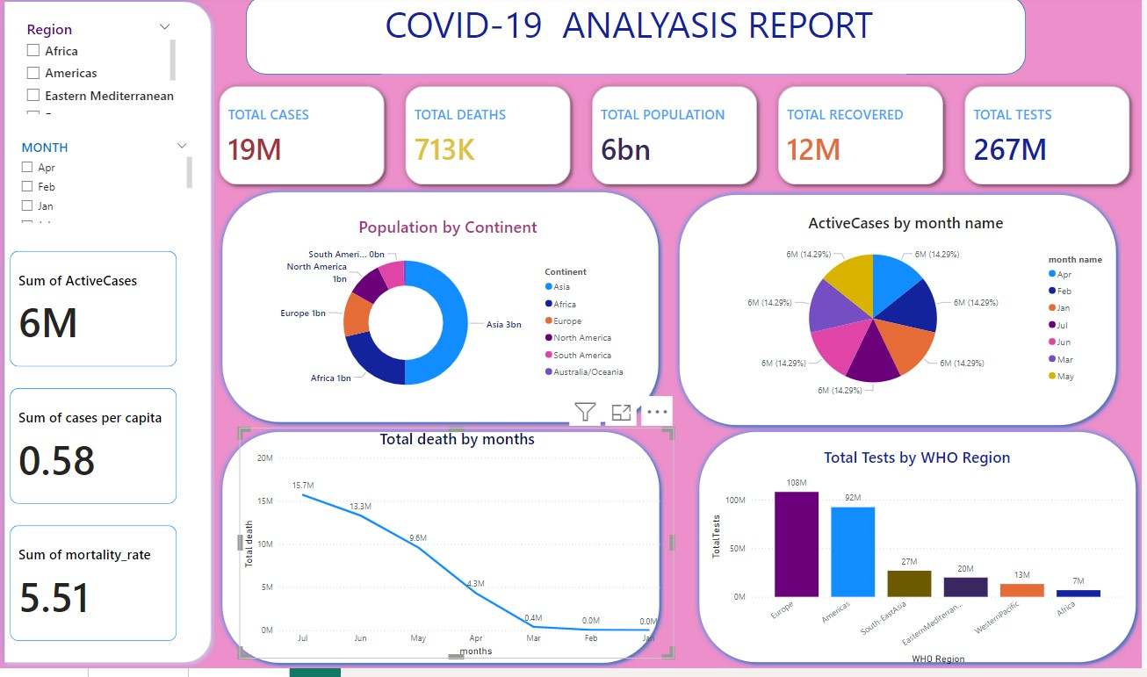

Slide 7
THANK YOU !

